Slide 1


Slide 2
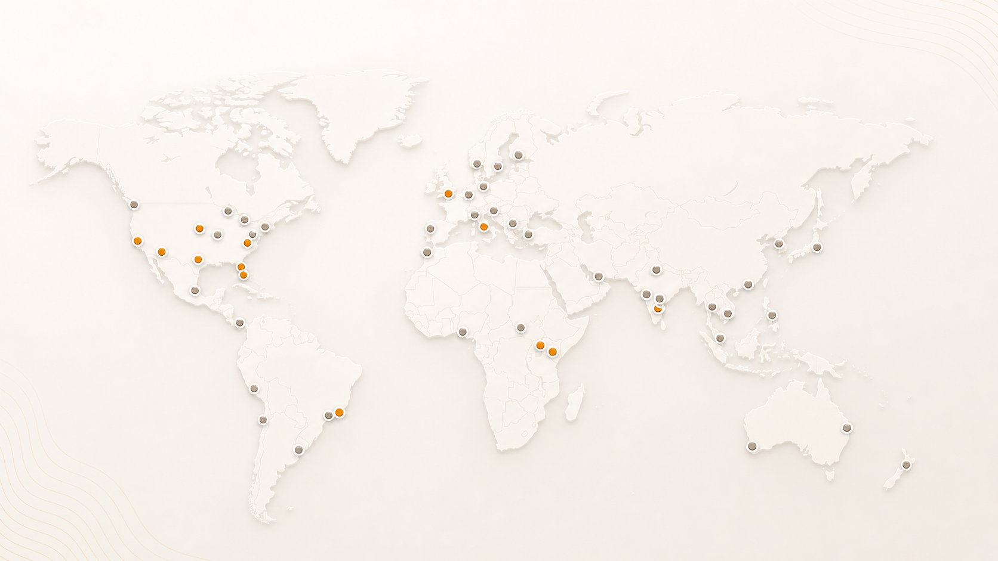
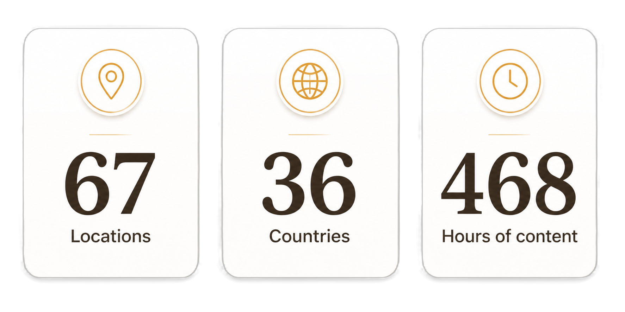
AgentCon around the world

Slide 3
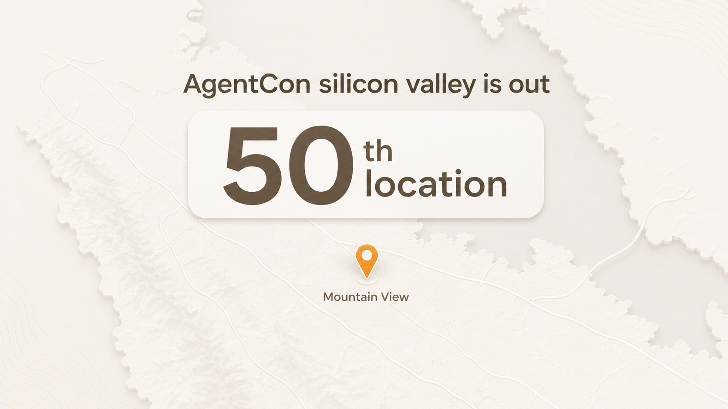

Slide 4
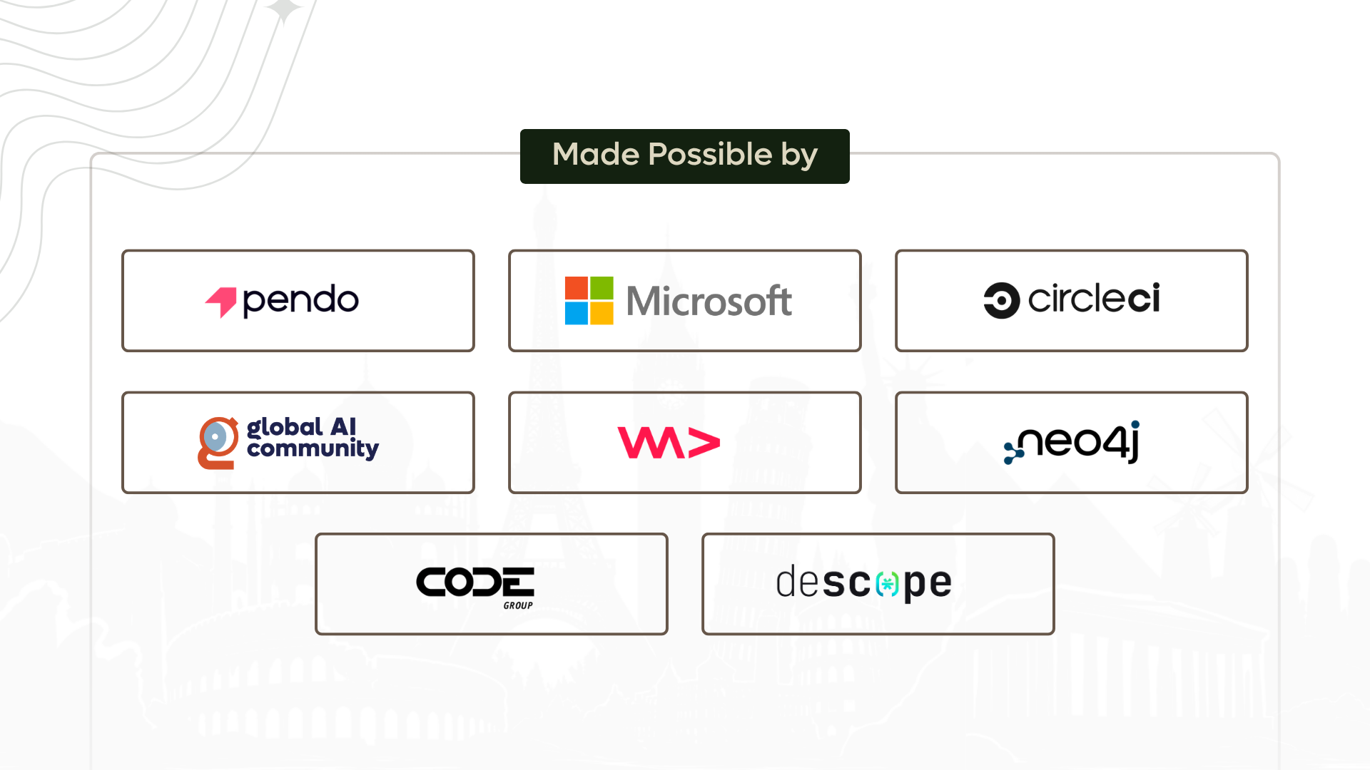

Slide 5
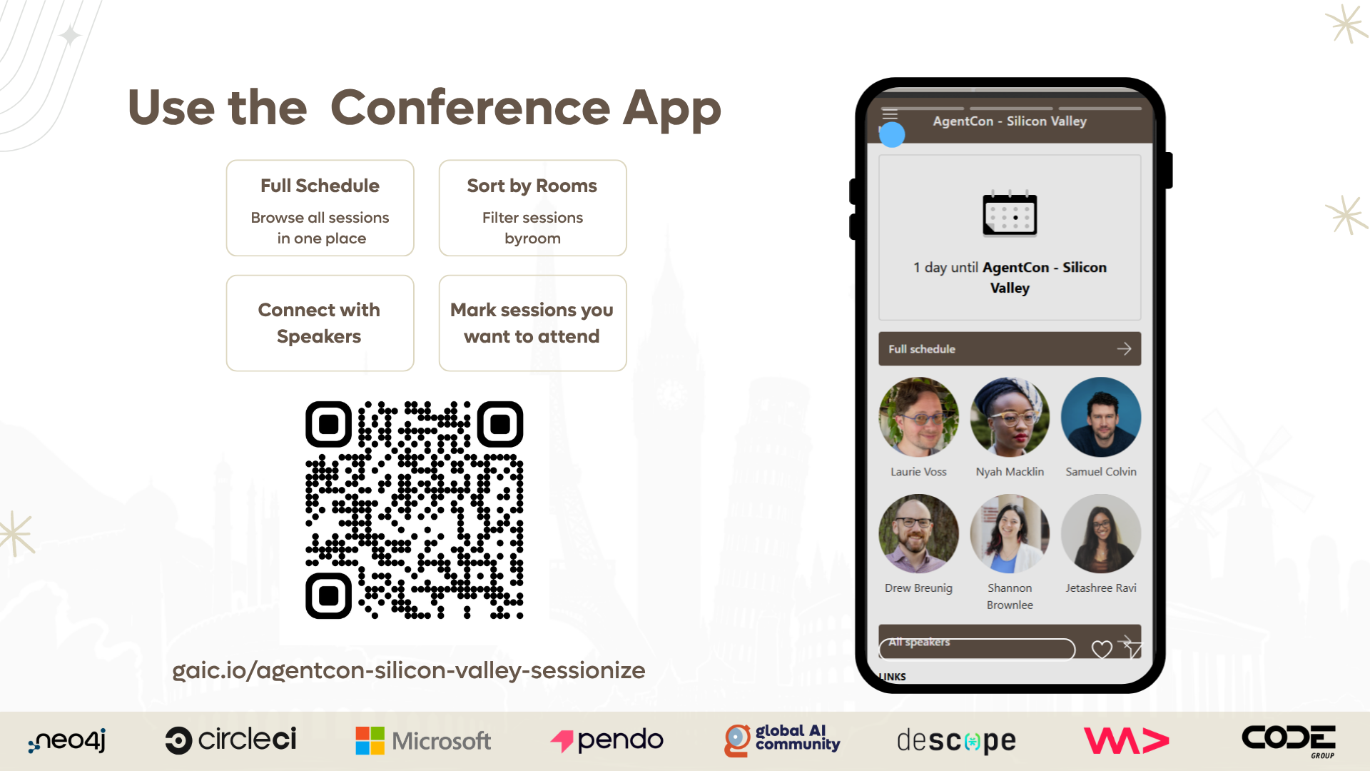

Slide 6
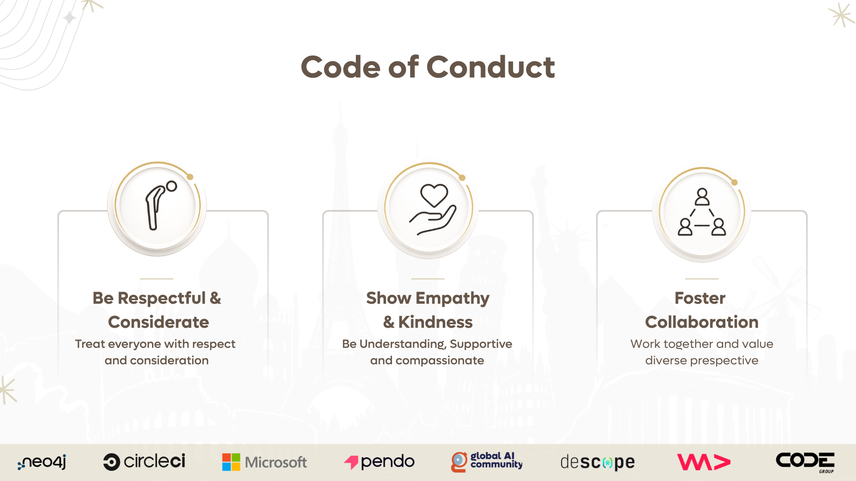

Slide 7
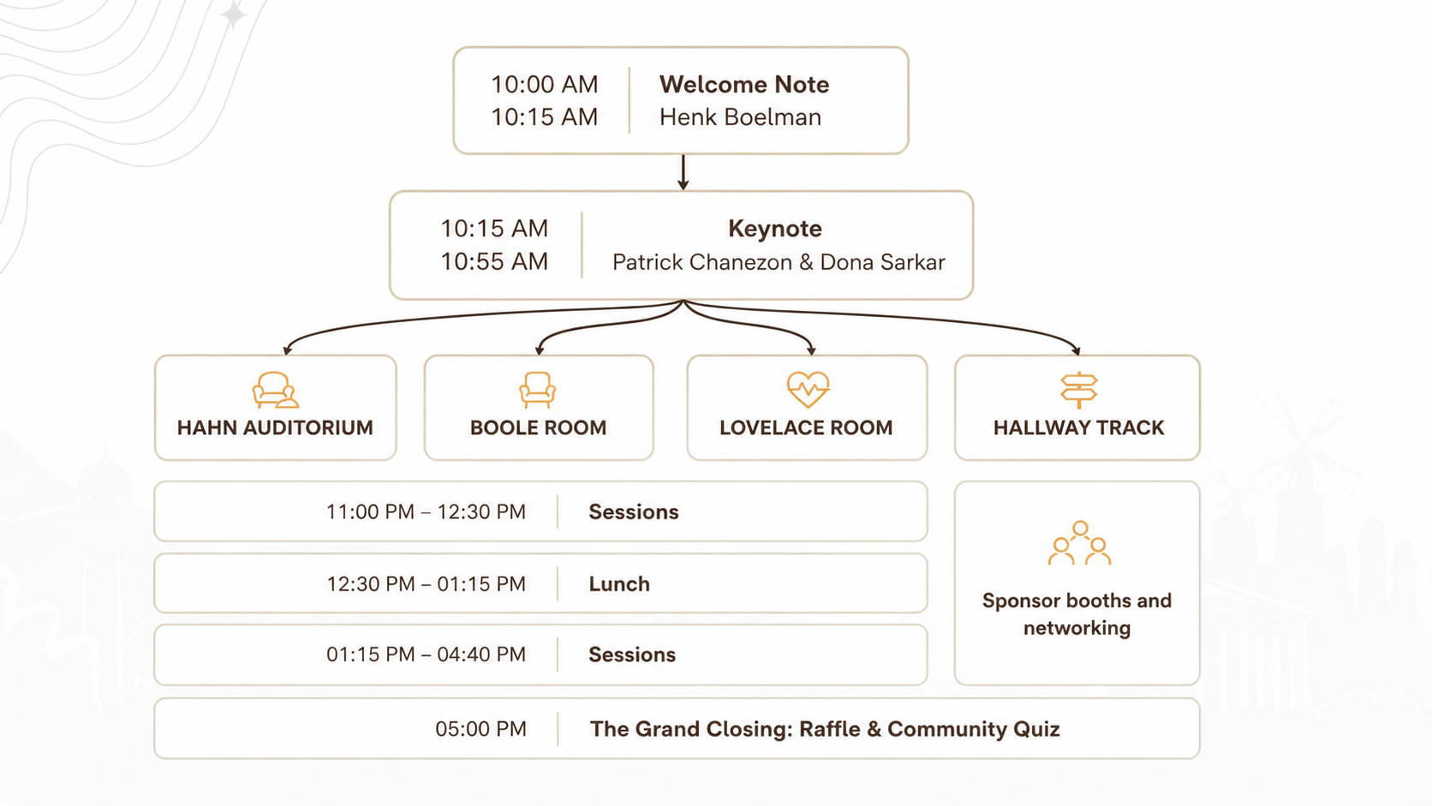

Slide 8

Join the AI Conversation on Discord
gaic.io/discord

Slide 9
Your feedback matters
Add feedback QR code here

Slide 10
Join the AI Conversation on Discord
gaic.io/discord

Slide 11
10:00 AM
10:15 AM
Welcome Note
Henk Boelman
10:15 AM
10:55 AM
Keynote
Patrick Chanezon & Dona Sarkar
HAHN AUDITORIUM
BOOLE ROOM
LOVELACE ROOM
HALLWAY TRACK
11:00 PM – 12:30 PM
Sessions
12:30 PM – 01:15 PM
Lunch
Sponsor booths and networking
01:15 PM – 04:40 PM
Sessions
05:00 PM
The Grand Closing: Raffle & Community Quiz

Slide 12






Part of the AgentCon World Tour by the Global AI Community
AI Agents Developer Conference
agentcon.city/hong-kong

Slide 13



Code of Conduct
Be Respectful &
Considerate
Show Empathy &
Kindness
Foster
Collaboration
globalai.community/about/code-of-conduct/

Slide 14







Made Possible by

Slide 15
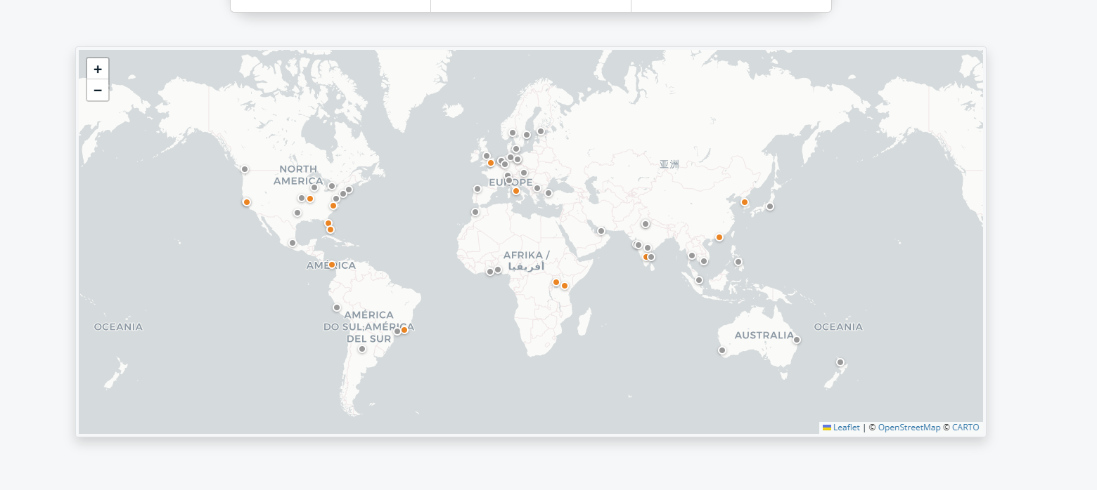
AgentCon Around the World
36
67
468
Locations
Hours of content
Countries

